Slide 1
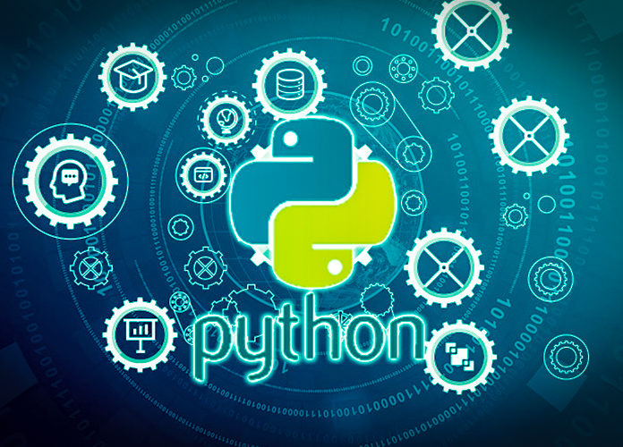
Data Programming in Python _________________ Module 7 Wrap-up

Slide 2
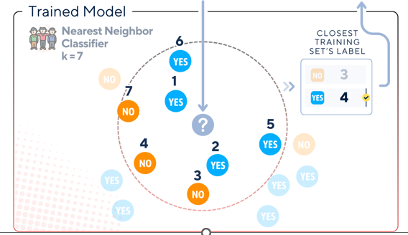
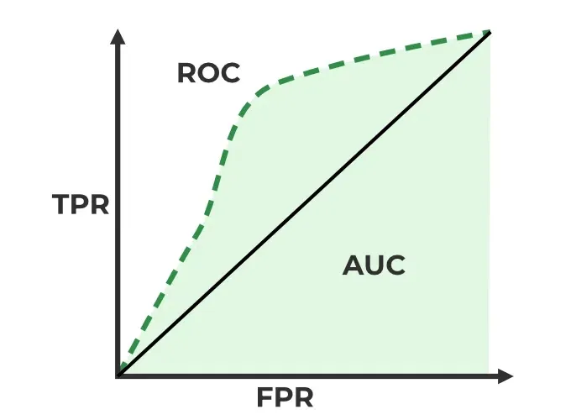
BAIS 6040: Data Programming in Python
Module Objectives:
Machine Learning Algorithms
Utilizing Scikit-learn for ML
Evaluate performance of models

Slide 3
BAIS 6040: Data Programming in Python
We learned:
Classification vs. Regression Algorithms
Training and testing data
Fitting and scoring a model
Adjusting parameters and choosing best model

